Slide 1

Hard Drives and File Systems
Date: October 2022

Slide 2

Summary of Information Covered
File Systems
New Technology File System
Disk Quotas
Attributes
Permissions
Shares

Slide 3
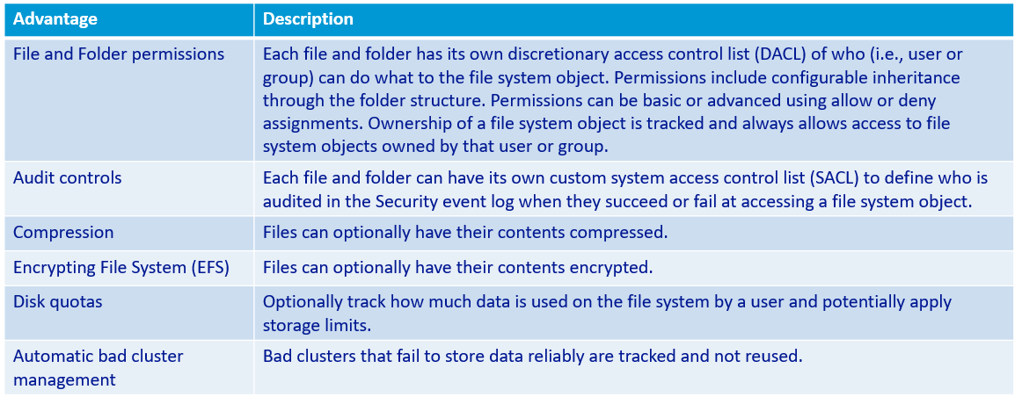
File Systems
Used New Technology File System (NTFS)

Slide 4
New Technology File System (NTFS): Disk Quotas
Disk Quotas
Amount of disk space used by a user can be limited
Set using the Disk Management console
As users approach limits, warnings can be issued
User-specific limits can be defined that override the default settings

Slide 5
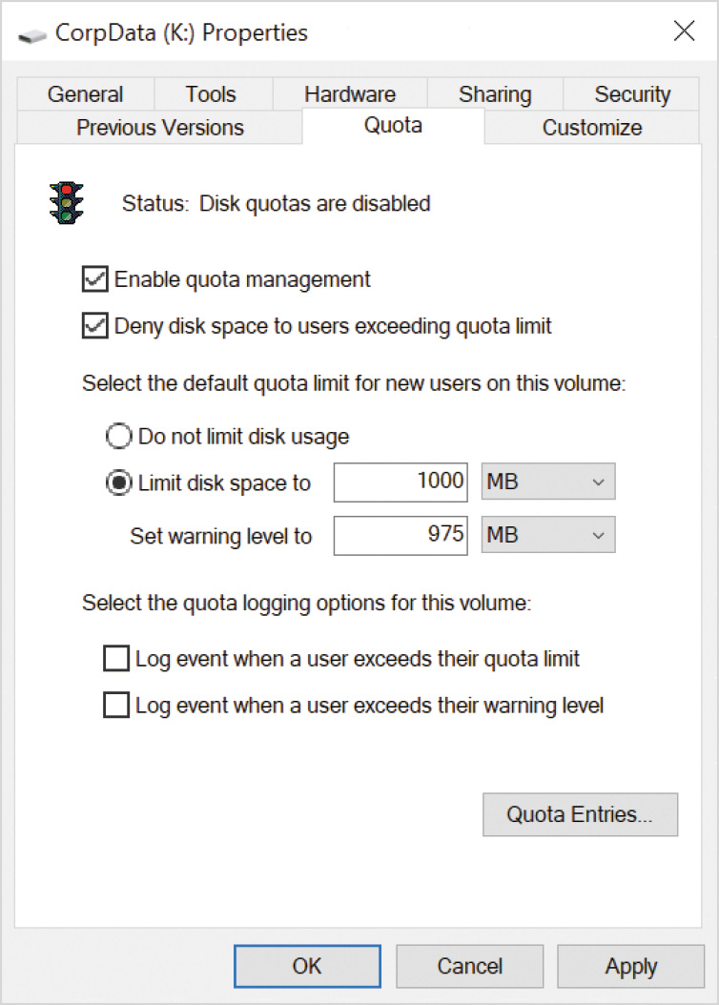
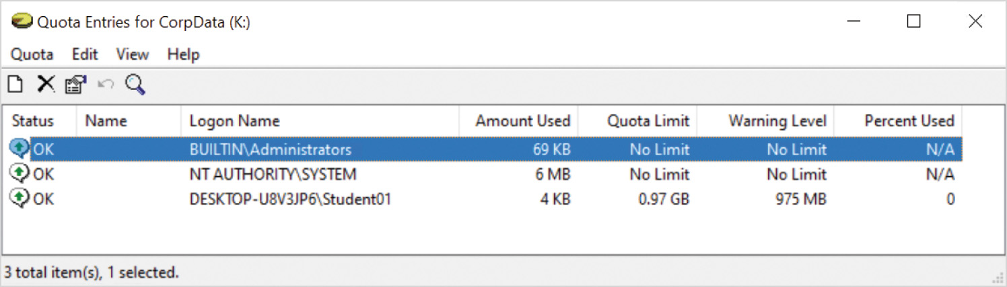
Disk Quotas cont’d
Figure 5-5 Quota entries for an NTFS-formatted disk
Figure 5-4 NTFS-formatted disk properties, disk Quota tab

Slide 6
File System – Drive Letters
Drive letters
Used by applications and users as a quick reference to locate files
Can change the drive letter, or assign a new one, to a partition or volume
Use the Disk Management console
A single drive letter can only be assigned to one partition or volume
Can remove drive letters from a partition or volume

Slide 7
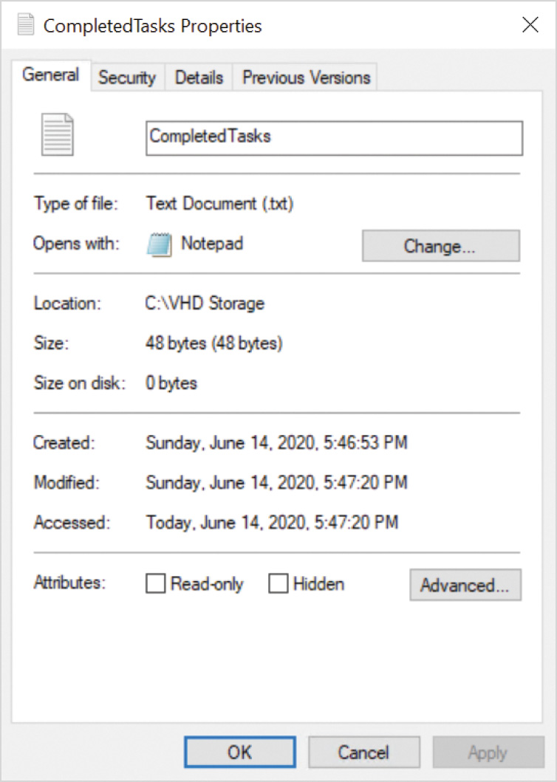
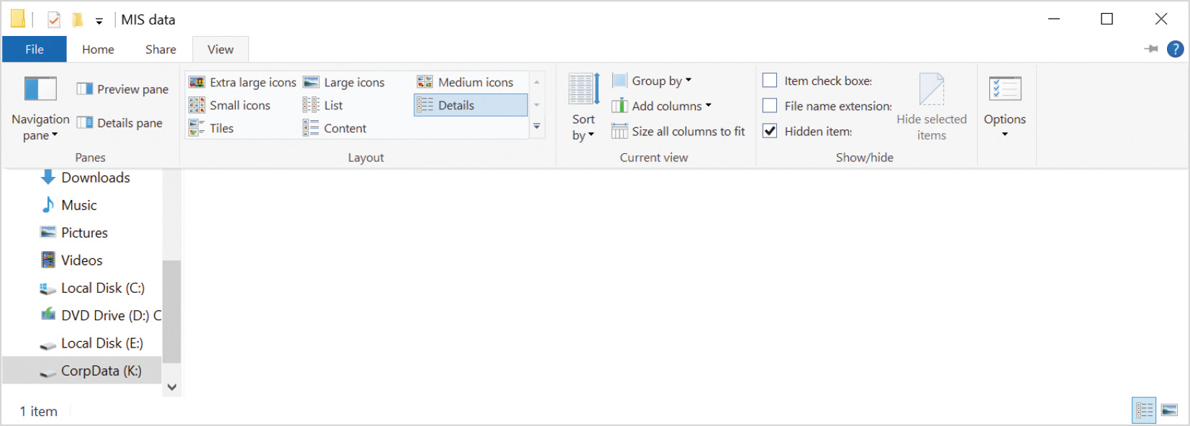
File and Folder Attributes
NTFS file systems use attributes
To describe general information about a file or folder
To see general attributes of a file or folder
View the properties of the item in File Explorer
The General tab displays basic attributes
Figure 5-6 Properties of a file on an NTFS file system, General tab
Figure 5-7 File Explorer, View tab, option to show hidden items

Slide 8
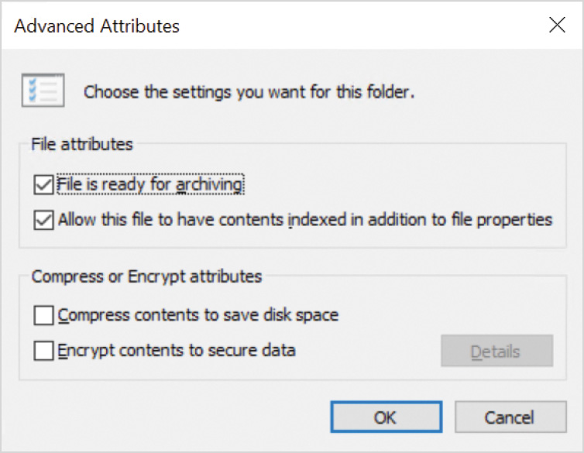
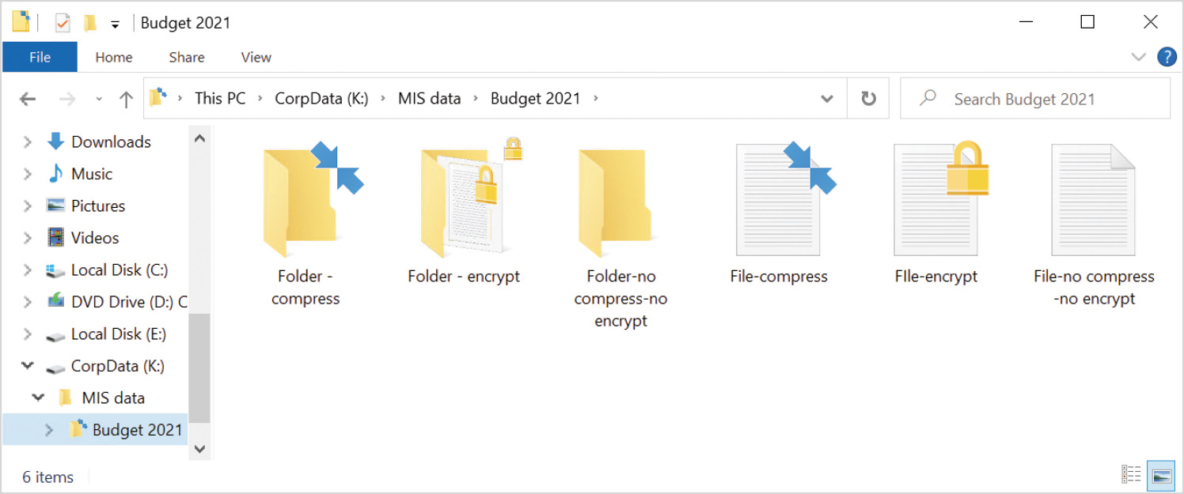
File and Folder Attributes cont’d
Figure 5-8 Properties of a file on an NTFS file system, General tab, Advanced Attributes
Figure 5-9 Modified icons to indicate compressed files and folders in File Explorer

Slide 9
Copying and Moving Files
A copied file
receives new attributes in the NTFS file system based on the attributes of the target folder
A moved file
When a file is moved within the same NTFS partition, the attributes do not change
When a file is moved to a new location in a different NTFS partition, the attributes become the same as the target folder’s attributes

Slide 10
PART II

Slide 11
File and Folder Permissions
Access Control List (ACL)
Collection of Access Control Entries (ACE)
Identify a specific security identifier (SID) can perform a given action to a file or folder
Used to specify what a user or group is allowed to do with the file or folder

Slide 12
Default Folder Permissions
First level of folder in an NTFS partition is root folder
Default permissions for the root folder on the C: drive
Members of Administrators group have full control
OS has full control
Members of Users group can read and execute programs
Authenticated users can create folders in this folder
Authenticated users can create files and write data in subfolders only
Default permissions for C: subfolders
Members of Administrators group have full control
OS has full control
Members of Users group can read and execute programs
Authenticated users can create, modify, and delete files and folders
In this folder and its subfolders

Slide 13
Permissions and Inheritance
Additional folders and files inherit permissions from the parent object that contains them
Inheritance allows a permission setting to propagate to lower subfolders
NTFS permissions are assigned using two formats
Basic NTFS permissions
Advanced NTFS permissions
Assigning and managing file permissions is seldom required for computer running Windows 10
Administrators have full access to entire system
Users have full access to their own profiles
Users to not have access to profiles of other users or the ability to modify system files

Slide 14
Basic NTFS Permissions
Collection of predetermined advanced NTFS permissions
Permission | Description
Write | This permission used for folders allows new files and folders to be created in the current folder. The folder attributes can be changed and the folder’s ownership and security can be viewed. This permission used for files allows file data to be rewritten. The file’s attributes can be changed and the file’s ownership and security can be viewed.
Read | This permission used for folders allows files and folder data, attributes, ownership, and security to be viewed. This permission used for files allows the file’s data, attributes, ownership, and security to be viewed.
List folder contents | This permission applies only to folders. Without this permission, the files and folders contained in a folder cannot be listed. The user or application can still access the files if they have permission and know the exact file or folder name.
Table 5-4 Basic NTFS Permissions

Slide 15
Basic NTFS Permissions cont’d
Permission | Description
Read & execute | This permission used for folders allows read access to files and folders below this point. This is the equivalent of enabling Read and List folder contents. This permission used for files allows read access to the file’s information and, if it is an executable file, the user is allowed to run it. This permission automatically includes the Read permission.
Modify | This permission used for folders allows the same actions as Write and Read & execute permissions combined. The folder can also be deleted. This permission used for files allows the same actions as Write and Read & Execute permissions combined. Files can also be deleted.
Full Control | This permission used for folders allows the same actions as Modify plus the ability to change permissions and allow a user to take ownership of the folder. This permission used for files allows the same actions as Modify plus the ability to change permissions and allow a user to take ownership of the file.
Special permissions | Special permissions are the advanced permissions that can be assigned when the predefined basic permissions are not adequate to achieve desired results.
Table 5-4 cont’d Basic NTFS Permissions

Slide 16
Types of Permissions
Explicit Permissions
Set by default when created
Set by User
Inherited Permissions
A Child Object obtains from Parent

Slide 17
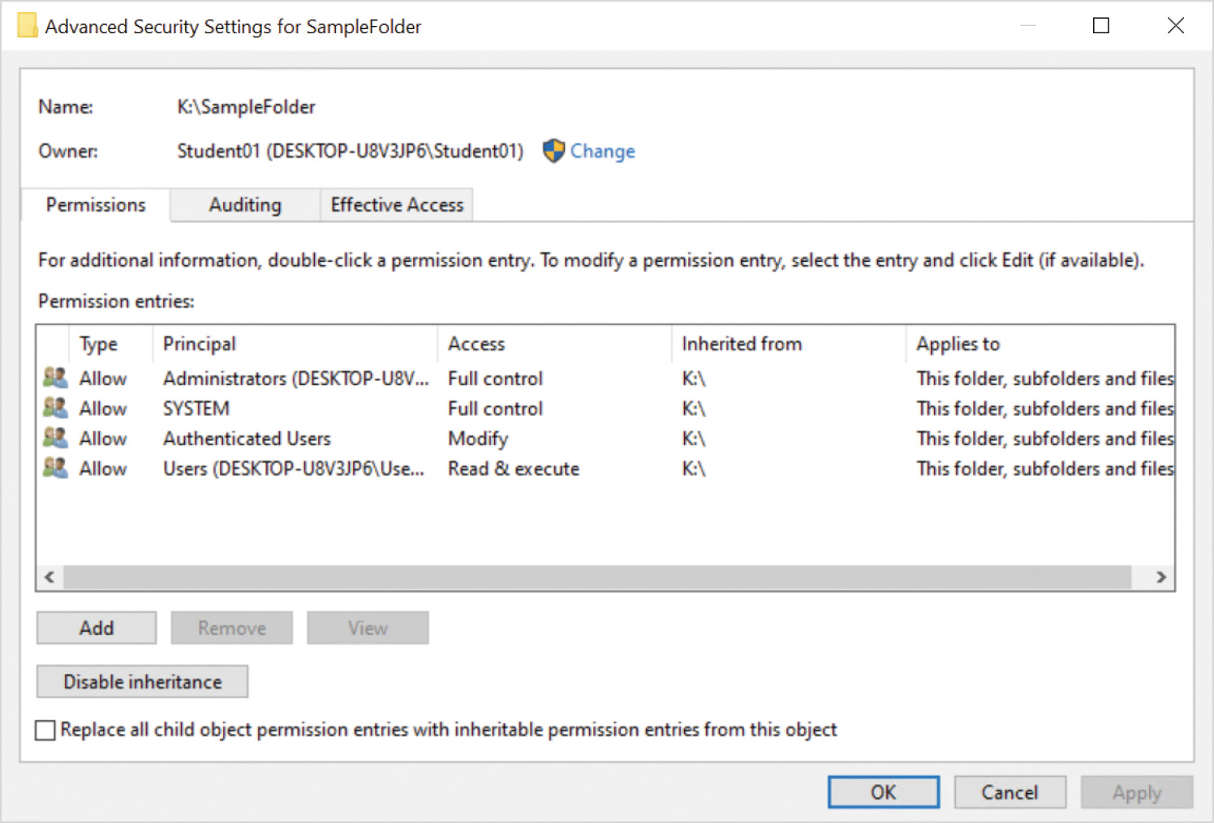
Permission Inheritance
NTFS permissions for folders apply to the first folder on which they are used
Permission propagates to all files and folders below that point
Inheritance can be blocked
Once blocked, the object needs new permissions assigned to it
Any file or folder can have additional permissions assigned directly to the object
That combine with the inherited permissions
Figure 5-13 Advanced security settings for an NTFS folder

Slide 18
PART III

Slide 19
Shared Folders
How many have access to a share
No limit on how many people can have access but
Maximum concurrent connections are 20 on windows computer
Limited by network availability on Windows server
Difference between sharename$ and $sharename
When $ is in front it often indicates a system or hidden file
When $ is at the end it is considered an industry standard to indicate a shared resource

Slide 20
Shared Folder Management
Shares
View shares, name, location and connections
Open share to view mas users, share permissions and NTFS permissions
Can set Offline setting if Offline files are turned on
Sessions
Show what users is connected to the share
Connection information such as location, type, connect time, idle time and # of open files
Allows you to disconnect a user if required
Open Files
See what file is open, who accessed it, and other information such as locks and mode
Files are usually locked when opened for edit
Open Mode usually means they are opened in Read Only
(PREVIEW Shared folder management)

Slide 21
Share Permissions
Share Permissions Available
Read
Change
Full Control
Net Share command
Preview or view share permissions similar to icacls command
Net share /?

Slide 22
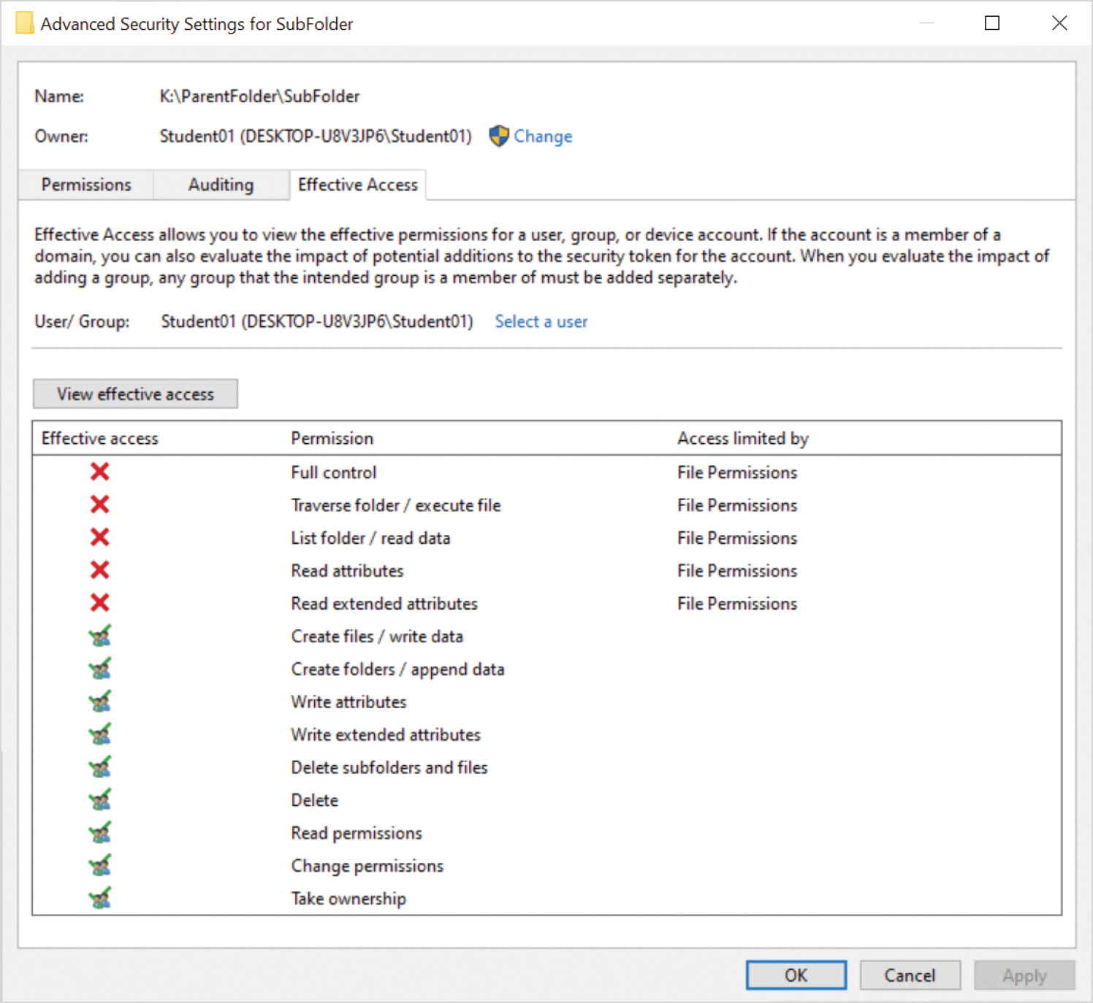
Effective Permissions
Items that impact calculating permissions
Permissions can be inherited or directly assigned
Permissions can be allowed or denied
Each permission has a scope that determines what range of objects it applies to
Users that do not have explicit permission assigned to an object and are not part of any inherited permission have no permission to the object
Users can be members in multiple groups that have different permissions to the same object
Owners of a file or folder have full control of the object
Figure 5-14 Effective Access tab in advanced file or folder security settings

Slide 23
Effective Permissions
Effective NTFS Permissions
Group Permission + User permission
Effective NTFS Permissions + Share Permissions
Effective NTFS Permission or Share Permissions which ever is most restrictive

Slide 24
Additional Learning Task
Watch the LinkedIn Video and complete the quiz at the end of Chapter 2 and 3.
Sharing folders (linkedin.com)

Slide 25

Questions

